Slide 1



Website for VFC Agro Foods
PROJECT MEMBERS
ROHANTH R B - 23ITR133
RIETHURAM A K - 23ITR129
(19ITR014)
PROJECT GUIDE
Dr.S.VARADHAGANAPATHY
Professor/Department of IT
Kongu Engineering College

Slide 2
COMPANY DETAILS
Company Name : VFC Agro Food Products Pvt.Ltd
Managing Director : Mr.P.Suresh Balaji
Address :1048/3B9 , pathanikadai pirivu , Nochiodapatti Post , Adiyanoothu Village , Dindigul - 624 003.
Contact :
Phone no: +91 90800 64455
Email: vfcagrofoods@gmail.com

Slide 3
OBJECTIVES
Design and develop a professional static website for VFC Agro Food Products Pvt. Ltd using HTML, CSS & JavaScript.
Showcase 10+ soft drink varieties with clear product presentation and branding.
Improve online visibility and provide a platform for product information.
Create a responsive and user-friendly layout accessible across devices.
3

Slide 4
Purpose of the Project
Establish online presence for the beverage manufacturing company
Showcase product range and company information
Provide customer contact and inquiry functionality
Build brand credibility and trust
4

Slide 5
System Requirements
Server Dependencies:
{
"express": "^4.x.x",
"nodemailer": "^6.x.x",
"cors": "^2.x.x",
"dotenv": "^16.x.x"
}
Environment Configuration:
Gmail SMTP credentials
Recipient email address
App-specific password setup
5

Slide 6
TECH STACK
Frontend Technologies:
HTML5 for semantic structure
CSS3 with modern styling (Flexbox, Grid)
Bootstrap 5 for responsive framework
JavaScript for interactivity
Google Fonts (Poppins) integration
Backend Technologies:
Node.js runtime environment
Express.js web framework
Nodemailer for email functionality
CORS middleware for cross-origin requests
dotenv for environment configuration
6

Slide 7
Modules
Frontend Module
Components:
Hero section with video background
About section with company information
Products showcase with interactive cards
Features section with hover effects
Contact form with client-side validation
Functionality:
Responsive design across all devices
Interactive product cards with hover effects
Video background with custom playback speed (0.75x)
Smooth navigation and scroll effects
Client-side form handling with fetch API
Real-time user feedback and status updates
7

Slide 8
Backend Module
Components:
Express.js web server
Static file serving middleware
CORS configuration
Email service with Nodemailer
Environment variable management
API endpoint for contact form
Functionality:
Serves frontend files at http://localhost:3000
/send-email API endpoint for form submissions
SMTP email delivery with HTML formatting
Error handling and logging
Security through environment variables
Cross-origin request support
8

Slide 9
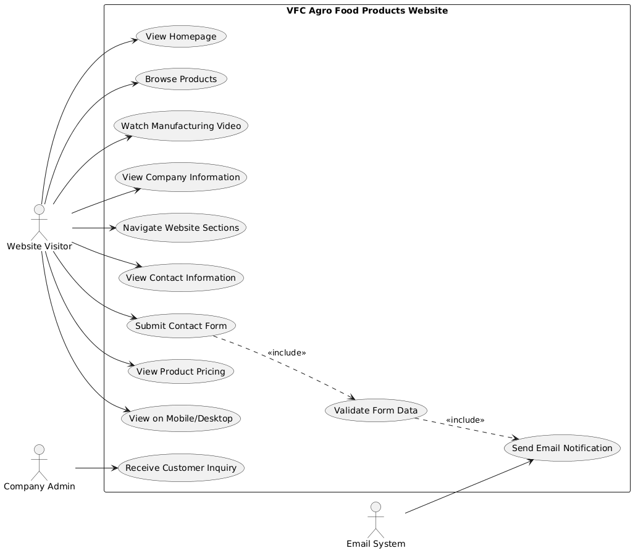
Usecase Diagram
9

Slide 10
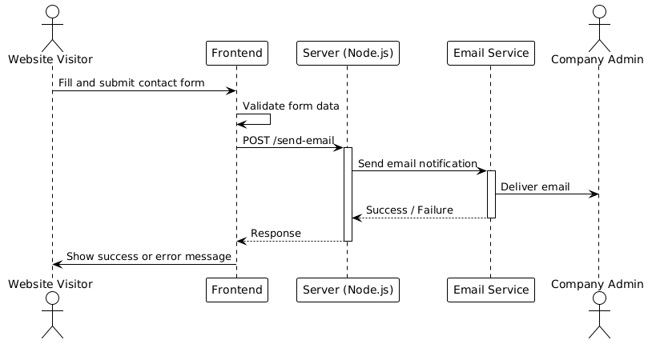
Sequence Diagram
10

Slide 11
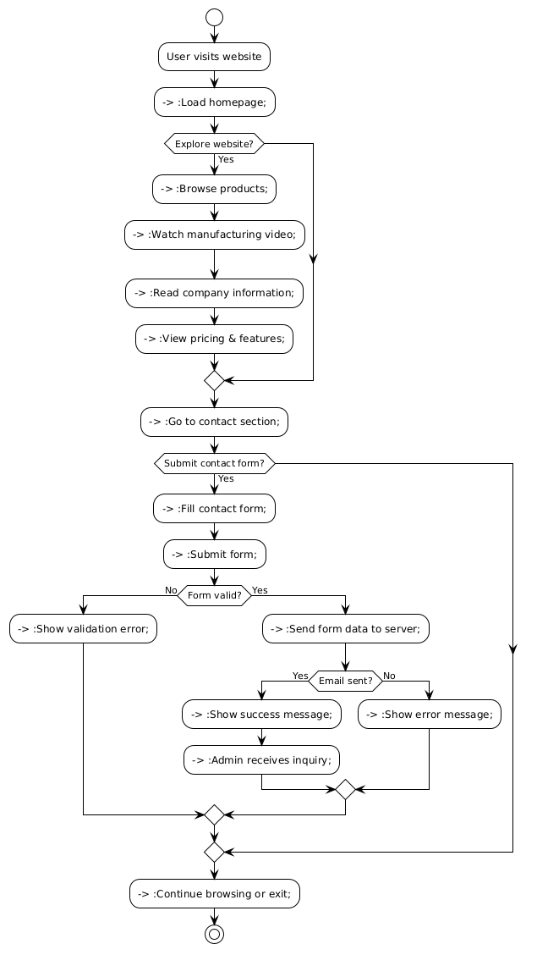
Activity Diagram
11

Slide 12

UI DESIGN

Slide 13
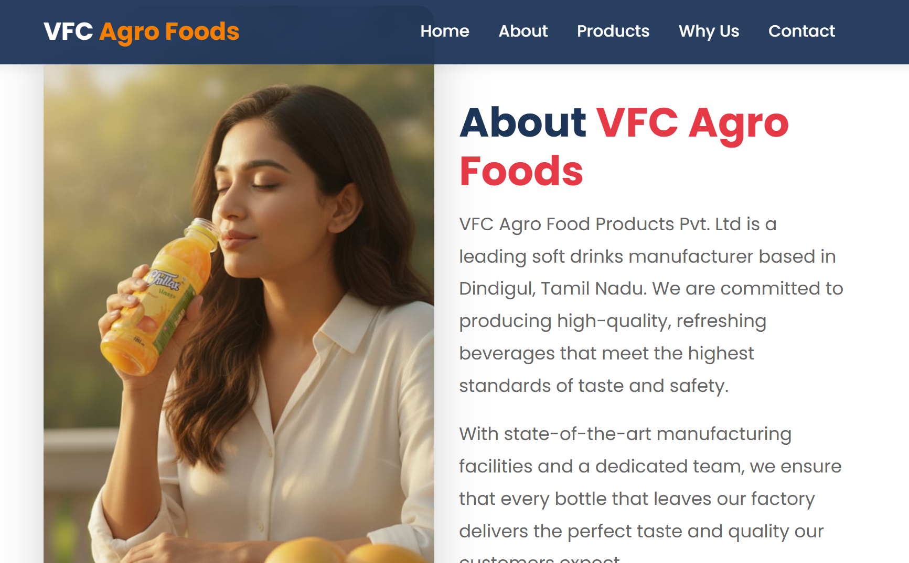

Slide 14
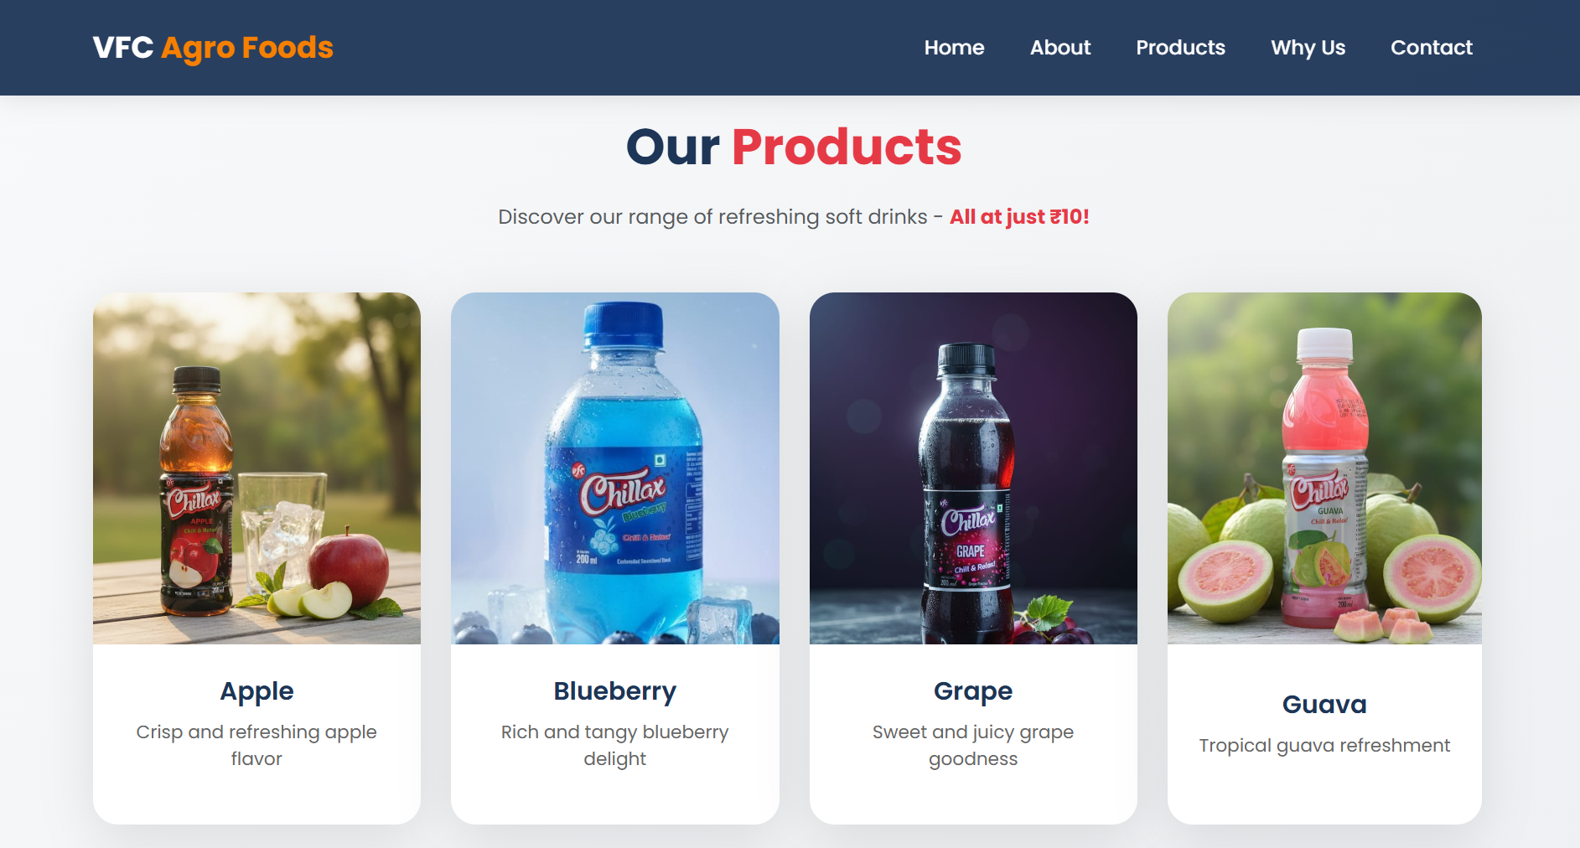

Slide 15


Slide 16
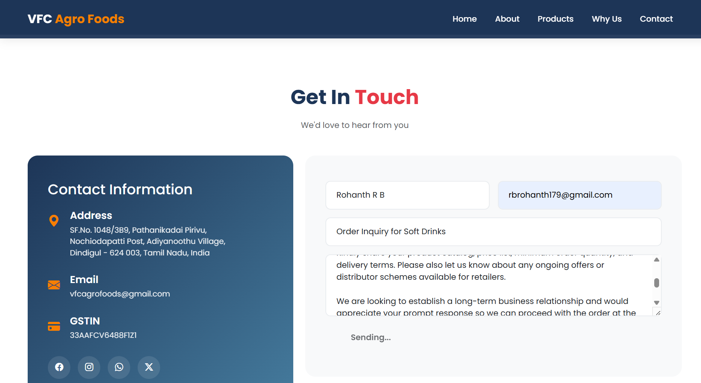
BACKEND
Sending the Email :

Slide 17
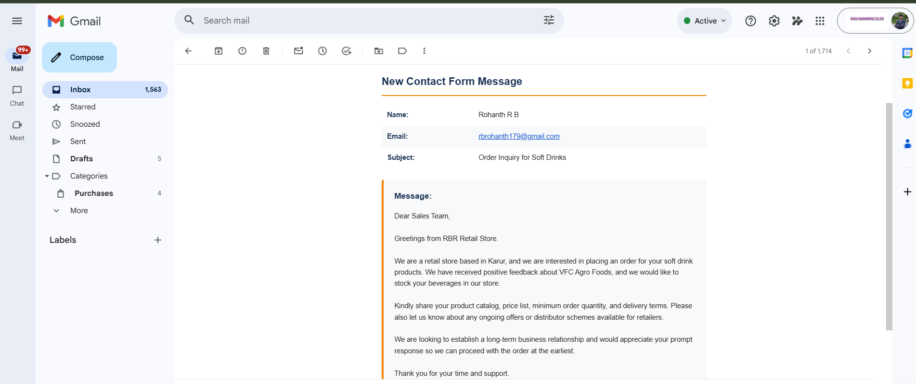
BACKEND
Receiving the Email :

Slide 18
Thank you!

